Slide 1

When AI helps the attacker Innovation's dark side
Martin Bosshardt
CEO, Anapaya

Slide 2

AI is changing the attack landscape – for the worse
Growth of AI-driven cyber-attacks
(2022-2025)
National Cyber Security Centre NCSC
250
It can generate convincingly realistic deepfake videos and power adaptive attack techniques that evade traditional security measures. Both the volume and sophistication of attacks will continue to grow.
200
150
Index (2022=100)
While AI does not fundamentally alter cybersecurity, it does accelerate existing trends. Most significantly, it lowers the barrier to launching cyberattacks – less technical knowledge is needed and attacks can be mounted more quickly.
100
50
0
2022
2023
2024
2025
Notes:
DDoS Attacks in 2025: Trends & Industry Insights | StormWall
Source: TotalAssure 2026 blog, 2022 baseline index, 72% YoY rise by 2025
Report on the influence of artificial intelligence in cybersecurity

Slide 3

AI is changing the attack landscape – for the worse
Growth of AI-driven cyber-attacks
(2022-2025)
Evolution of AI-Powered DDoS Tools
“DDoS-as-a-Service” platforms now often include built-in functionality based on tools like WormGPT and FraudGPT, which are widely used to generate attack scripts.
250
200
150
AI-driven malicious systems are increasingly capable to monitor traffic patterns in real time, identify weaknesses in a target’s defenses, and dynamically adjust attack parameters to avoid detection or strike at the most effective moment — such as during maintenance windows or peak load periods.
Index (2022=100)
100
50
0
2022
2023
2024
2025
Notes:
DDoS Attacks in 2025: Trends & Industry Insights | StormWall
Source: TotalAssure 2026 blog, 2022 baseline index, 72% YoY rise by 2025
Report on the influence of artificial intelligence in cybersecurity

Slide 4
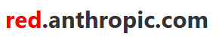
Anthropic’s Mythos is just one example
During our testing, we found that Mythos Preview is capable of identifying and then exploiting zero-day vulnerabilities in every major operating system and every major web browser when directed by a user to do so. The vulnerabilities it finds are often subtle or difficult to detect.
Assessing Claude Mythos Preview’s cybersecurity
capabilities
Non-experts can also leverage Mythos Preview to find and exploit sophisticated vulnerabilities. Engineers at Anthropic with no formal security training have asked Mythos Preview to find remote code execution vulnerabilities overnight, and woken up the following morning to a complete, working exploit.
April 7, 2026

Slide 5
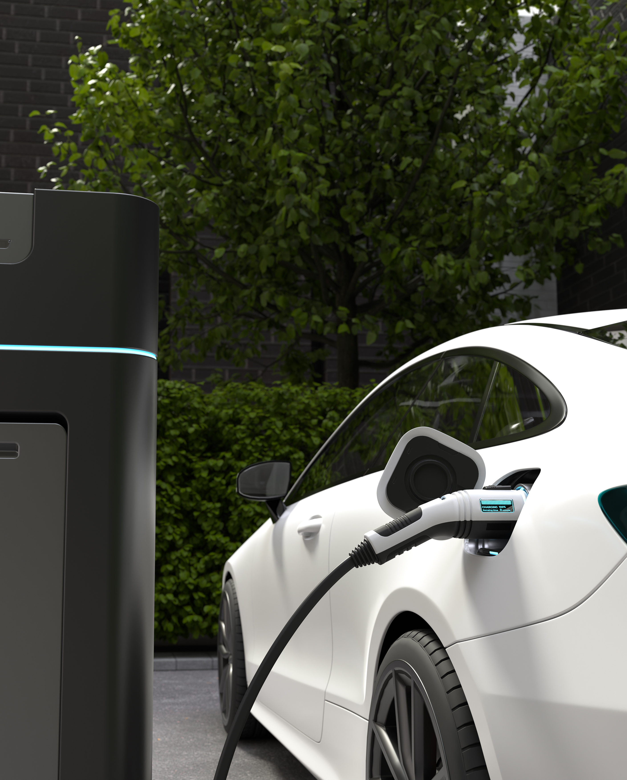
Internet of Things (IoT) dangerous growth factor
Charging stations, solar panels, wind turbines, heating units…
Growth of Connected IoT Devices Over the Last 10 years
30
25
20
Number of Connected IoT Devices (in billions)
15
10
5
2014
2016
2018
2020
2022
Year
Source: IoT Analytics, Statista

Slide 6
Zero-day attacks have been increasing in frequency The Internet eats itself…
100
80
Reported worldwide Zero-Day attacks (2014-2024)
60
Number of Zero-Day Attacks
40
20
2014
2015
2016
2017
2018
2019
2020
2021
2022
2023
2024
Year

Slide 7















AI-driven attacks are a reality, go-to security products are proven to be vulnerable
# of Zero-days (2024-1Q26)
8
4
12
10
2
4
2024 | 2025 | 1Q26
Impacted enterprises
©2026 Anapaya. All Rights Reserved.
Notes:
CISCO, 12 total zero days in 2024–1Q26
Apr 24, 2024, ArcaneDoor (1), CVE-2024-20353, UK Government, Government of Canada | Source: NCSC UK Joint Advisory / Canadian Centre for Cyber Security (CCCS).
Apr 24, 2024, ArcaneDoor (2), CVE-2024-20359, UK Government, Government of Canada | Source: Cisco Talos Intelligence Event Response.
Jun 25, 2025, Identity Plane (1), CVE-2025-20281, Swiss Government (BIT), United Nations (UN) | Source: Swiss Federal Office of IT (BIT) Press Release / UNDP Investigative Report.
Jun 25, 2025, Identity Plane (2), CVE-2025-20282, United Nations (UN) | Source: UN Internal Infrastructure Audit Report.
Sep 25, 2025, Firewall Crisis, CVE-2025-20333,
Sep 25, 2025, Access Bypass, CVE-2025-20362,
Sep 25, 2025, IOS Core RCE, CVE-2025-20363,
Sep 25, 2025, Memory Attack, CVE-2025-20352,
Dec 17, 2025, Email Gateway, CVE-2025-20393,
Jan 21, 2026, Unified CM RCE, CVE-2026-20045,
Feb 25, 2026, SD-WAN Fabric Auth Bypass, CVE-2026-20127,
Feb 25, 2026, SD-WAN API File Overwrite, CVE-2026-20122,
CITRIX / NETSCALER, 8 total zero days in 2024–1Q26
Jan 16, 2024, Admin Access, CVE-2023-6548, Boeing | Source: Reuters / Boeing Global Services Disclosure.
Jan 16, 2024, Edge Disruption, CVE-2023-6549,
Jan 2024 (Impact), CitrixBleed, CVE-2023-4966, ICBC (Industrial and Commercial Bank of China), Fidelity (Fidelity National Financial) | Source: Bloomberg / FNF SEC Form 8-K Filing.
Jun 17, 2025, Profile Leak, CVE-2025-5349, Fidelity (Fidelity Investments) | Source: Fidelity Investments Internal Incident Disclosure.
Jun 25, 2025, CitrixBleed 2.0, CVE-2025-5777, ICBC (ICBC Global) | Source: Financial Times / ICBC Infrastructure Security Report.
Jun 25, 2025, NetScaler Logic Bypass, CVE-2025-6543,
Aug 2025, Salt Typhoon 1, Internal ID 2025-A, AT&T | Source: Wall Street Journal / FBI August 2025 Espionage Briefing.
Feb 2026, Salt Typhoon 2, Internal ID 2025-B, AT&T | Source: FBI / CyberScoop February 2026 Telecom Threat Briefing.
IVANTI, 10 total zero days in 2024–1Q26
Jan 10, 2024, Initial Access, CVE-2023-46805, Government of Norway | Source: Norwegian National Security Authority (NSM) Official Report.
Jan 10, 2024, Command Takeover, CVE-2024-21887, Government of Norway | Source: NSM Joint Advisory.
Jan 31, 2024, Privilege Flow, CVE-2024-21888,
Jan 31, 2024, SSRF Chain, CVE-2024-21893, Government of Norway (12 Ministries) | Source: NSM Norwegian Government Breach Analysis.
May 31, 2024, EPM SQLi, CVE-2024-29824,
Jan 8, 2025, VPN Overflow, CVE-2025-0282, University of Oxford | Source: The Guardian / Oxford IT Services Disclosure.
Jan 8, 2025, VPN RCE, CVE-2025-0283, University of Oxford | Source: CyberScoop / Oxford Research Network Incident Report.
Jan 14, 2025, EPM Traversal, CVE-2024-13159,
Jan 30, 2026, MDM Attack (EPMM RCE), CVE-2026-1281, Government of Norway | Source: NSM Norway Security Update.
Jan 30, 2026, App Distribution Code Injection, CVE-2026-1340,
PALO ALTO NETWORKS, 4 total zero days in 2024–1Q26
Apr 12, 2024, Lunar Peek (GlobalProtect), CVE-2024-3400, Chevron | Source: S&P Global / Volexity Operation MidnightEclipse Report.
Nov 18, 2024, Admin Bypass (PAN-OS), CVE-2024-0012,
Nov 18, 2024, Chain Attack (PAN-OS), CVE-2024-9474,
Feb 12, 2025, Persistence, CVE-2025-0108,
FORTINET, 4 total zero days in 2024–1Q26
Feb 8, 2024, SSL-VPN RCE, CVE-2024-21762, Government of Iceland | Source: CERT-IS (Iceland National CERT) Public Alert.
Oct 23, 2024, FortiJump (FortiManager), CVE-2024-47575, Government of Canada (Global Affairs Canada) | Source: Canadian Centre for Cyber Security (CCCS).
Jan 23, 2026, SSO Zero-Day, CVE-2026-24858, AXA (AXA Switzerland Partner Gateway) | Source: AXA Switzerland Security Bulletin Jan 2026.
Apr 16, 2026, EMS Critical RCE, CVE-2026-35616, NHS Scotland | Source: NHS Dumfries and Galloway Official Statement.
CATO NETWORKS, 2 total zero days in 2024–1Q26
May 16, 2024, TunnelVision (DHCP), CVE-2024-3661, Tesla | Source: Leviathan Security Group Technical Case Study.
Jan 2025, Client Privilege Flow, CVE-2025-3886,

Slide 8

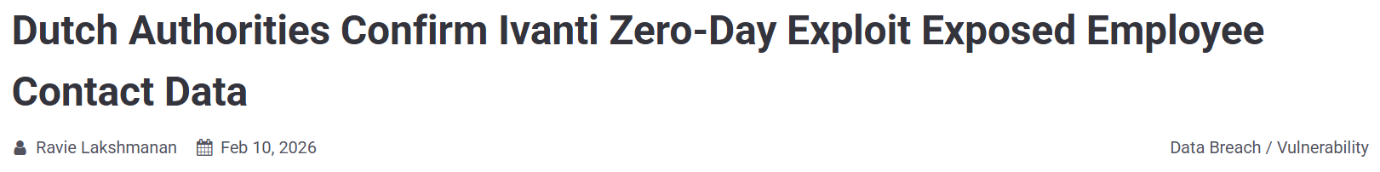


Critical infrastructure has a target on its back
Dutch Authorities Confirm Ivanti Zero-Day Exploit Exposed Employee Contact Data
The Netherlands' Dutch Data Protection Authority (AP) and the Council for the Judiciary confirmed that their systems were impacted by cyber attacks that exploited the recently disclosed security flaws in Ivanti Endpoint Manager Mobile (EPMM), according to a notice sent to the country's parliament on Friday.
"On January 29, the National Cyber Security Center (NCSC) was informed by the supplier of vulnerabilities in EPMM," the Dutch authorities said.
"It is now known that work-related data of AP employees, such as names, business email addresses, and telephone numbers, have been accessed by unauthorized persons.”
©2026 Anapaya. All Rights Reserved.
Notes:
Dutch Authorities Confirm Ivanti Zero-Day Exploit Exposed Employee Contact Data

Slide 9

1 VPN Zero day -> 1’700 compromised enterprises in 5 days
A zero-day vulnerability on Ivanti remote access product is discovered…
In 5 days, at least 1,700 corporates were reported to be compromised!
// INTELLIGENCE
// INTELLIGENCE
Active Exploitation of Two Zero-Day Vulnerabilities in Ivanti Connect Secure VPN
Ivanti Connect Secure VPN Exploitation Goes Global
Compromised VPN devices used to pivot into internal networks and exfiltrate data
Over 1’700 compromised Ivanti Connect Secure VPN devices worldwide
Victims spread across nearly all verticals, including military, defense, government, financial & technology
January 10, 2024
→ 5 Days →
January 15, 2024
©2026 Anapaya. All Rights Reserved.

Slide 10
The superpowers of SCION – Isolated from Internet
By implementing security on the network level, enterprises benefit from…
Business continuity
End to end security
Unprecedented control
To mitigate internet security risks: become internet free

Slide 11


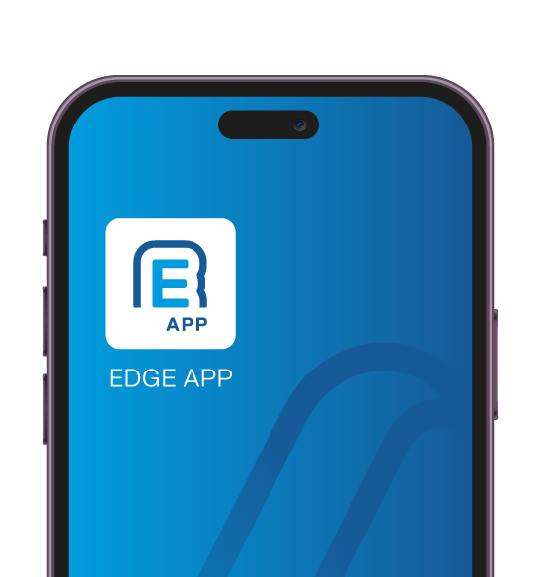
SCION’s architecture supports multiple use cases
Closed user-groups for secure
cross-organizational comms
Access to SCION Internet to users of certain ISPs
Secure connectivity to the end device of specific users
Secure Swiss Finance Network inter-connecting >100 financial institutions and running CHF interbank clearing
eHealth provider HIN enabling secure communication between 50k doctors, HIN and other eHealth applications
App Software Development Kit (SDK) for leading Swiss bank to secure eBanking on phones

Slide 12


SCION gives you end-to-end secure connectivity
E-banking
End users securely connect from anywhere
Sensitive data is
not exposed to the Internet
Always available, unaffected by downtime
Transition your service to be structurally immune to attackers

Slide 13
Isolation in action: Critical services behind SCION
Validated user’s journey
eBanking user upgrades App in the App store as usual
Authorization infrastructure
Hidden Path Service
E-banking
SNAP
Internet
eBanking infrastructure

Slide 14
Isolation in action: Critical services behind SCION
Validated user’s journey
eBanking user upgrades App in the App store as usual
User opens the App, not even realizing they’re connecting to the SCION internet via a SCION Network Access Point (SNAP)
Authorization infrastructure
Hidden Path Service
E-banking
SNAP
Internet
eBanking infrastructure

Slide 15
Isolation in action: Critical services behind SCION
Validated user’s journey
eBanking user upgrades App in the App store as usual
User opens the App, not even realizing they’re connecting to the SCION internet via a SCION Network Access Point (SNAP)
The Hidden Path Service checks and gives them access to the authorization service
Authorization infrastructure
Hidden Path Service
E-banking
SNAP
Internet
eBanking infrastructure

Slide 16
Isolation in action: Critical services behind SCION
Validated user’s journey
eBanking user upgrades App in the App store as usual
User opens the App, not even realizing they’re connecting to the SCION internet via a SCION Network Access Point (SNAP)
The Hidden Path Service checks and gives them access to the authorization service
User enters eBanking login credentials in their App
Authorization infrastructure
Hidden Path Service
E-banking
SNAP
Internet
eBanking infrastructure

Slide 17
Isolation in action: Critical services behind SCION
Validated user’s journey
eBanking user upgrades App in the App store as usual
User opens the App, not even realizing they’re connecting to the SCION internet via a SCION Network Access Point (SNAP)
The Hidden Path Service checks and gives them access to the authorization service
User enters eBanking login credentials in their App
All is correct, and they gain access to eBanking on a single use, isolated hidden path
Authorization infrastructure
Hidden Path Service
E-banking
SNAP
Internet
eBanking infrastructure

Slide 18
Isolation in action: Critical services behind SCION
Structural invisibility from attackers
A malicious actor tries to access the service
Authorization infrastructure
Hidden Path Service
E-banking
SNAP
Internet
eBanking infrastructure

Slide 19
Isolation in action: Critical services behind SCION
Structural invisibility from attackers
A malicious actor tries to access the service
They don’t get path information to the target, the critical infrastructure is completely invisible and unreachable
×
Authorization infrastructure
Hidden Path Service
E-banking
SNAP
Internet
eBanking infrastructure

Slide 20






Hear it from the industry leaders themselves
Financial services
Government / Defense
“With SCION, we have achieved the desired resilience against cyberattacks.”
“SCION offers more control and security. The innovation ecosystem around SCION is unique.”
William Boye | Head of Network Services
Dr. Vincent Lenders| Former Head of Cyber-Defense Campus
Healthcare
Utilities
“SCION renders our connections invisible, away from malicious actors.”
“With this next-generation SCIONabled SOC, we are better positioned than ever to protect critical infrastructure for years to come.”
Urs Fischer| Head of Innovation
Manuel Dietrich | CTO
Notes:
30 sec- mb
Strong references in Switzerland like the SNB, SIX or the ArmaSuisse
and a growing SCION ecosystem are giving us confidence further expand this technology outside Switzerland.

Slide 21
































SCION - the new standard in secure communication

Slide 22
SCION uses existing infrastructure to generate cost savings and business benefits from Day 1
Our customers did the math – Return on Investment (ROI) study​ shows SCION provides returns as fast as within 9 months.​
Use the ROI Calculator – please ask our team!

Slide 23
Become an Internet-free company with SCION
Measured & Proven¹
Move beyond reliance on the public Internet
Scans in M
Malicious attacks
-99.8%
-100%
Create an isolated and controlled environment
8.8M
Replace exposure with secure, resilient connectivity
0
Internet
SCION Internet
Internet
SCION Internet
Notes:
The only viable answer: isolate from the public Internet and move beyond the classic BGP model.
Adopt the next-generation Internet architecture — SCION — purpose-built for critical infrastructure.
No end-user visibility or exposure, similar to BGP routing principles.
SCION establishes a new security and resilience standard for critical infrastructure.

Slide 24




Our team at SCION Day
Jesper Kühl
Roel Cruz
Vani van Nielen
Business Development
Business Development
Business Development
Follow us on LinkedIn
Olivier Moll
Kyveli Mavromati
Aashima Vasudeva
COO
Customer Success
Customer Success

